Slide 1
CS112 | OOP PROJECT
Air University, Multan Campus
BSSE-II | 2nd Semester | Spring 2026
⚖
Crime Case Tracking &
Investigation Report System
A C++ OOP Console Application
LAW ENFORCEMENT
SIMULATION
Team Members
Alishba Razzaq — Roll No. 2510301 Kashmala Rizwan — Roll No. 2510279

Slide 2
TABLE OF CONTENTS
01
Project Introduction
05
UML Class Diagram
What, why & the story behind the project
Inheritance hierarchy and class relationships
02
Class Structure
06
Demo
7 classes with roles and responsibilities
Console walkthrough of the running system
03
Scope of Project
07
Conclusion
What the system covers and its boundaries
Summary and what we learned
04
Functional & Non-Functional Requirements
System features and quality standards

Slide 3
PROJECT INTRODUCTION
The Story
Every crime needs a record. Every case needs an investigator. Every piece of evidence needs to be logged. But what happens when a department still relies on paper files and manual logs? Cases get lost. Evidence gets mixed up. Reports take days.
We built the Crime Case Tracking & Investigation Report System — a C++ console application that brings law enforcement record-keeping into a clean, organized, class-based system.
🗂
⚙
🎯
The Problem
The Solution
The Goal
Manual paper-based records cause errors, delays and data loss in law enforcement
A structured OOP system: register cases, link suspects, assign investigators, log evidence
Demonstrate real-world OOP design — inheritance, encapsulation, polymorphism — in one project

Slide 4
CLASS STRUCTURE
PersonBase
CrimeScene
T1 — Base Class
T2 — virtual CrimeBase
fullName, nationalID, nationality, contactNumber
sceneCondition, witnessCount, forensicFound, sceneSecured
CrimeBase
EvidenceRecord
T1 — Base Class
T2 — virtual CrimeBase
caseID, crimeType, crimeDate, crimeLocation
evidenceID, evidenceType, collectedBy, labResult
SuspectProfile
CaseInvestigationReport
T2 — extends PersonBase
T3 — CrimeScene + EvidenceRecord
suspectCode, criminalRecord, arrestStatus, riskLevel
reportID, verdict, caseStatus, approvedBy
InvestigatorProfile
T2 — extends PersonBase
badgeNumber, rank, department, yearsExperience

Slide 5
SCOPE OF THE PROJECT
💻
🧩
📂
Platform
OOP Coverage
Multi-Case
Console-based C++ — no GUI required
Inheritance, encapsulation, polymorphism, virtual functions
Multiple cases with linked suspects, investigators & evidence
🔗
🗃
📐
Hybrid Inheritance
In-Memory Data
Scalable Design
Multiple + virtual inheritance without ambiguity
All data stored in-memory at runtime — no file or DB storage
Class structure easily extended with more features later

Slide 6
FUNCTIONAL REQUIREMENTS
📁
Register a new crime case with ID, type, date and location
👤
Add suspect profiles with criminal record and risk level, linked to a case
🔍
Assign an investigator with badge number, rank and department
🏚
Record crime scene details including forensic findings and witness count
🧪
Log evidence with type, collector name and lab analysis result
📄
Generate a final investigation report combining all case data
🔐
All data accessed only through getters and setters (encapsulation)
🖥
Simple console menu to navigate between all features

Slide 7
NON-FUNCTIONAL REQUIREMENTS
🧹
Memory Safety
🔒
Encapsulation
Virtual destructors in all base classes — no memory leaks in dynamic allocation
All attributes private or protected — zero public data members
🔗
No Ambiguity
📋
Readability
Virtual inheritance resolves the diamond problem in CaseInvestigationReport
Clean class design — each class has a single clear responsibility
⚡
Performance
🔧
Maintainability
All operations run in-memory — instant response, no I/O delay
Modular class structure — easy to extend or add new classes later

Slide 8
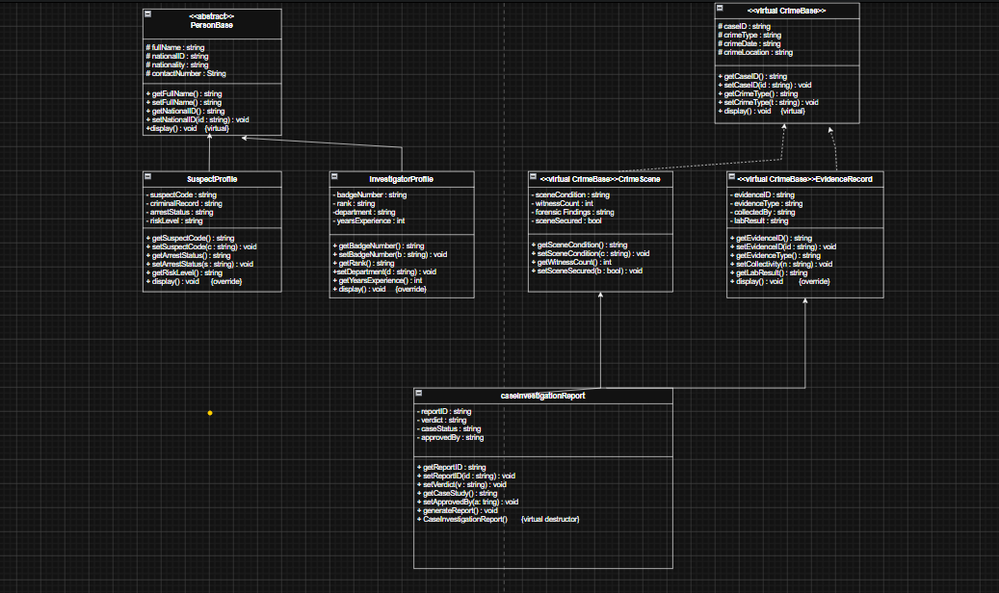
UML CLASS DIAGRAM

Slide 9
DEMO — SYSTEM WALKTHROUGH
● ● ●
Crime Investigation System — C++
01
Launch the program
╔══════════════════════════════════════╗
Console menu appears with all options
║ CRIME CASE TRACKING SYSTEM v1.0 ║
02
Register a Case
╚══════════════════════════════════════╝
Enter caseID, crime type, date and location
03
Add Suspect
[1] Register New Crime Case
[2] Add Suspect Profile
Link suspect with risk level and arrest status
[3] Assign Investigator
04
Assign Investigator
[4] Record Crime Scene
Set badge number, rank and department
[5] Log Evidence
[6] Generate Investigation Report
05
Log Evidence & Scene
[0] Exit
Record forensic findings and evidence details
06
Generate Report
Enter choice: _
Full case report with verdict and status printed

Slide 10
CONCLUSION
What We Built
A fully functional C++ console application that simulates a law enforcement record-keeping system. The project covers 7 interconnected classes, hybrid inheritance (multiple + virtual), full encapsulation, and safe dynamic memory management — all applied to a real-world scenario.
🔗
🔒
🎭
💡
Inheritance
Encapsulation
Polymorphism
Design Thinking
Single, multiple & virtual inheritance used in one project
Private/protected data with consistent getter/setter pattern
Virtual destructors ensuring safe object cleanup
Mapped a real problem to a clean class-based OOP solution

Slide 11
⚖
Thank You!
Crime Case Tracking & Investigation Report System
Alishba Razzaq • 2510301 Kashmala Rizwan • 2510279
BSSE-II | CS112 | 2nd Semester | Spring 2026 | Air University, Multan Campus

